Slide 1
End-to-End Deep Reinforcement Learning for Self-Driving Car Agents
Artificial Intelligence Project
Milad Ebrahimi
Saeed Tahmasebi
Winter 2019

Slide 2
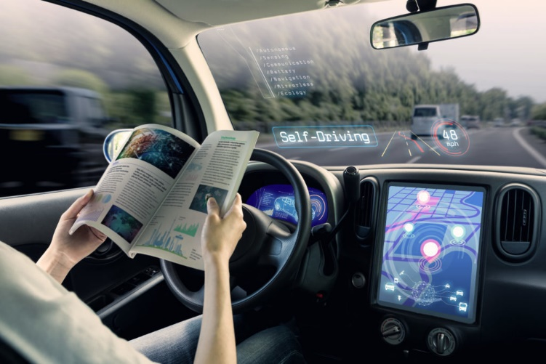
What Are Self Driving Cars?

Slide 3
What was the problem?
Low Safety
High Traffic
Lack of Time
Driving of Handicapped People
…

Slide 4
What did we do?
Search and re-search
Implementation
Evaluation

Slide 5
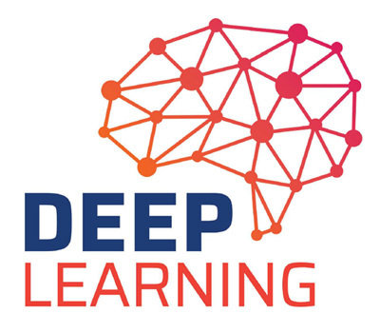
What is our solution?
Offline Deep Reinforcement Learning

Slide 6

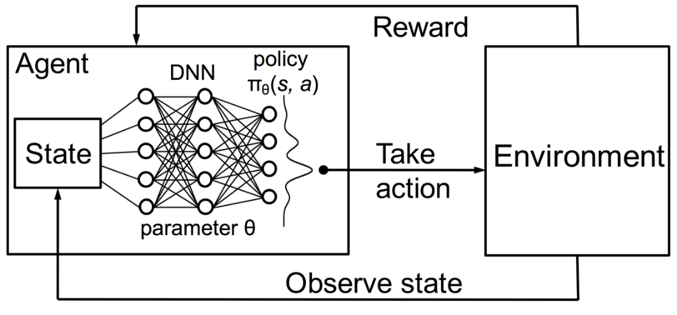
What is Deep Reinforcement Learning?
Reinforcement Learning
Deep Reinforcement Learning

Slide 7



What did we use?

Slide 8
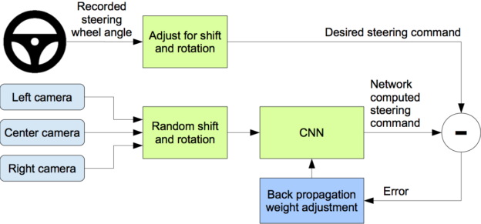
Implementation

Slide 9
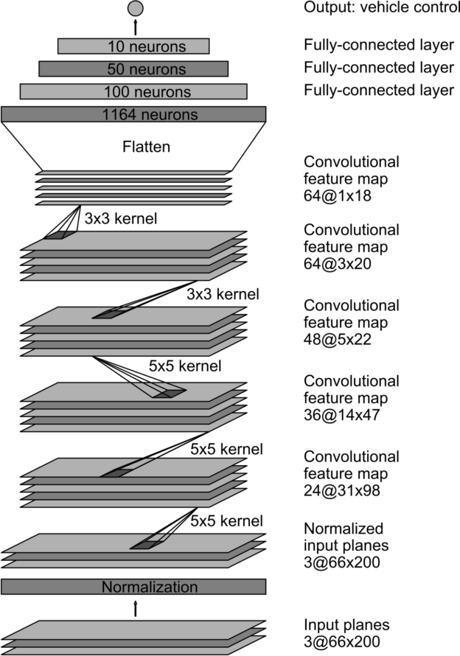
More Implementation
Network Model

Slide 10
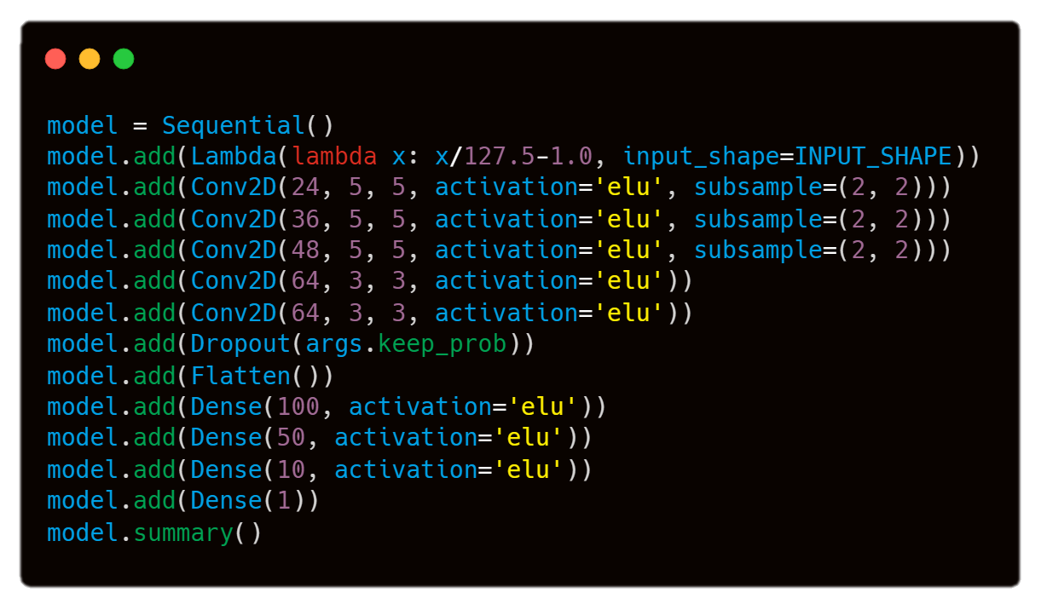
The Code

Slide 11
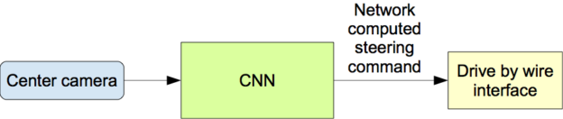
After Learning

Slide 12
Challenges
Learning new Concepts
There is no Dataset
Implementing Controller Interface
Lack of Good Hardware

Slide 13
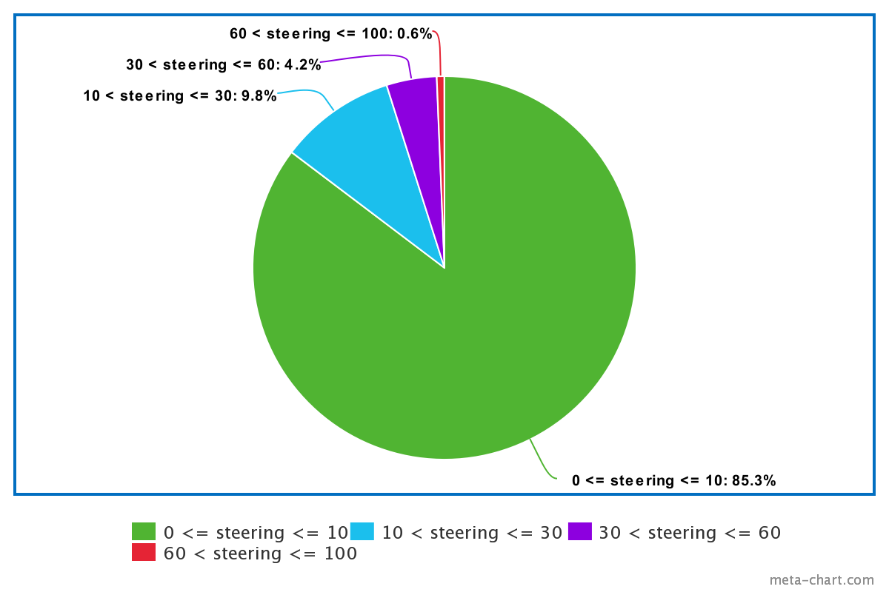
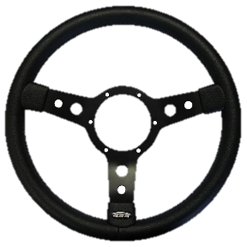
Let’s Learn
Simple Road
First We Should Drive

Slide 14
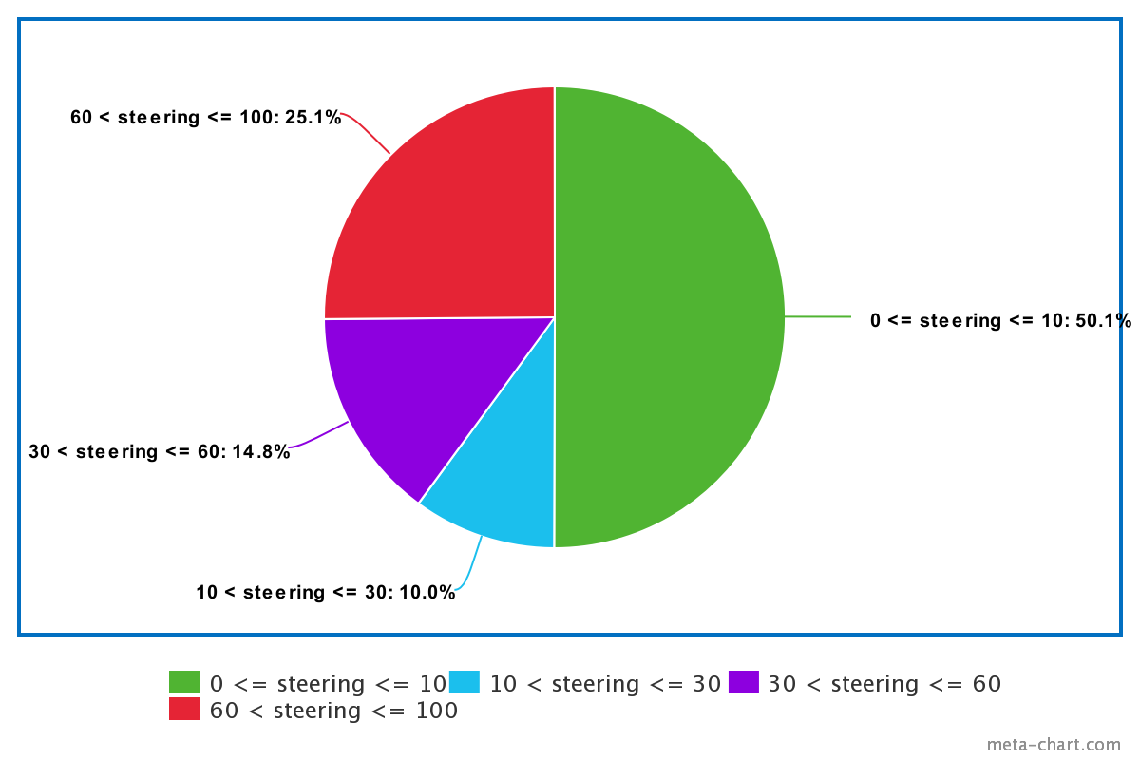
Let’s Learn
Complex Road
First We Should Drive

Slide 15
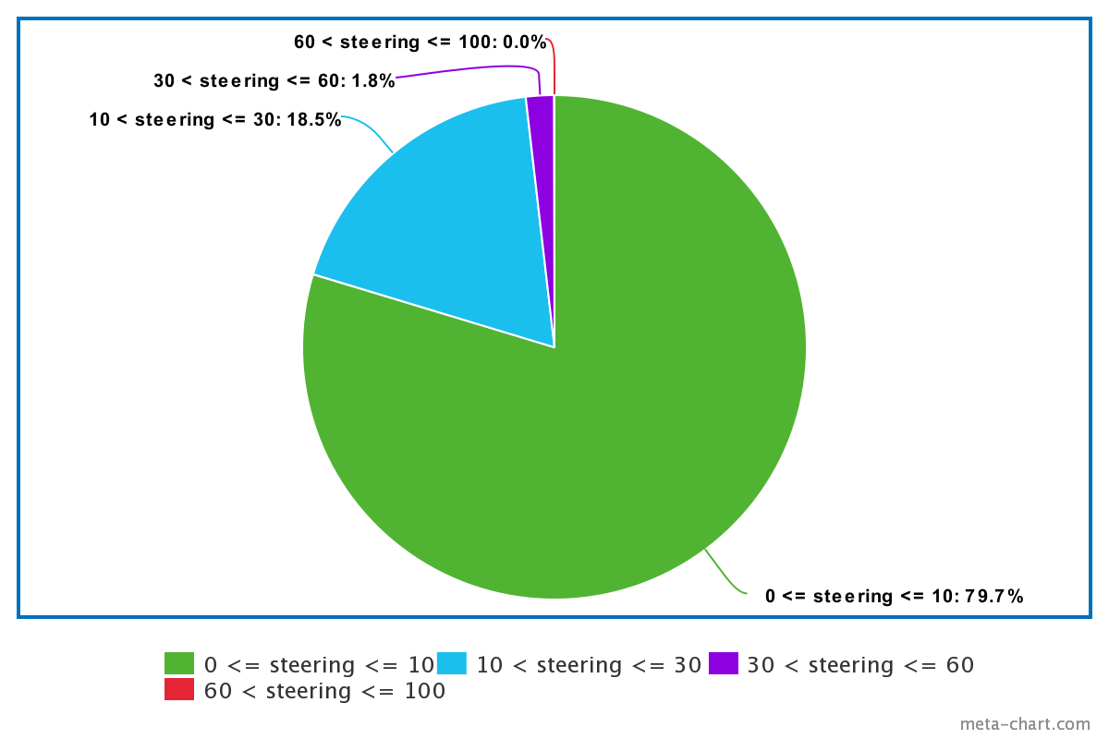
Let’s Not Drive Anymore!
In Simple Road
Input Data
Result Data
91.9 % Similarity. Amazing!

Slide 16
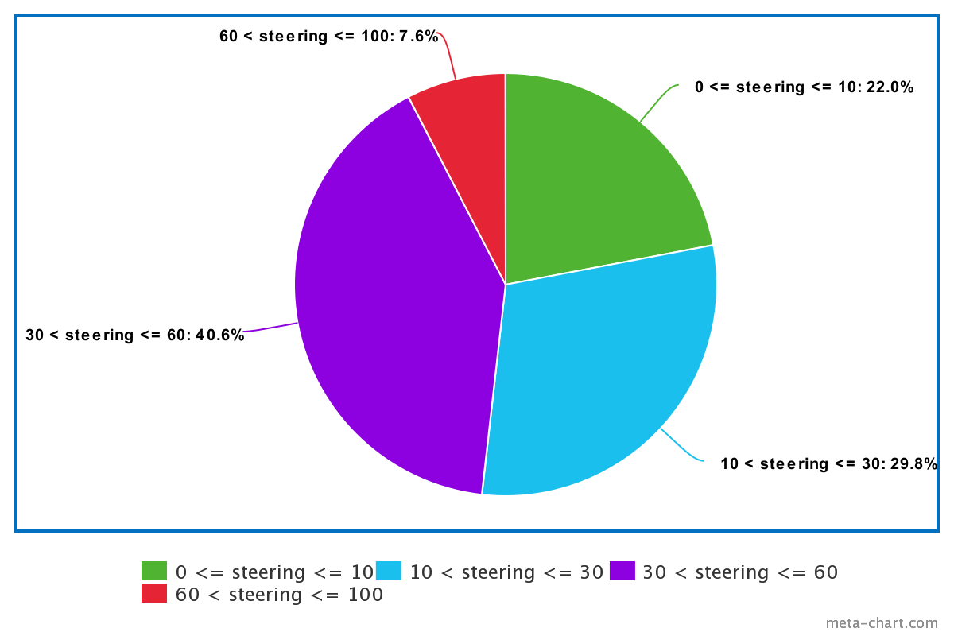
Let’s Not Drive Anymore!
In Complex Road
Input Data
Result Data
54.4 % Similarity. At Least It Doesn't Fail!

Slide 17
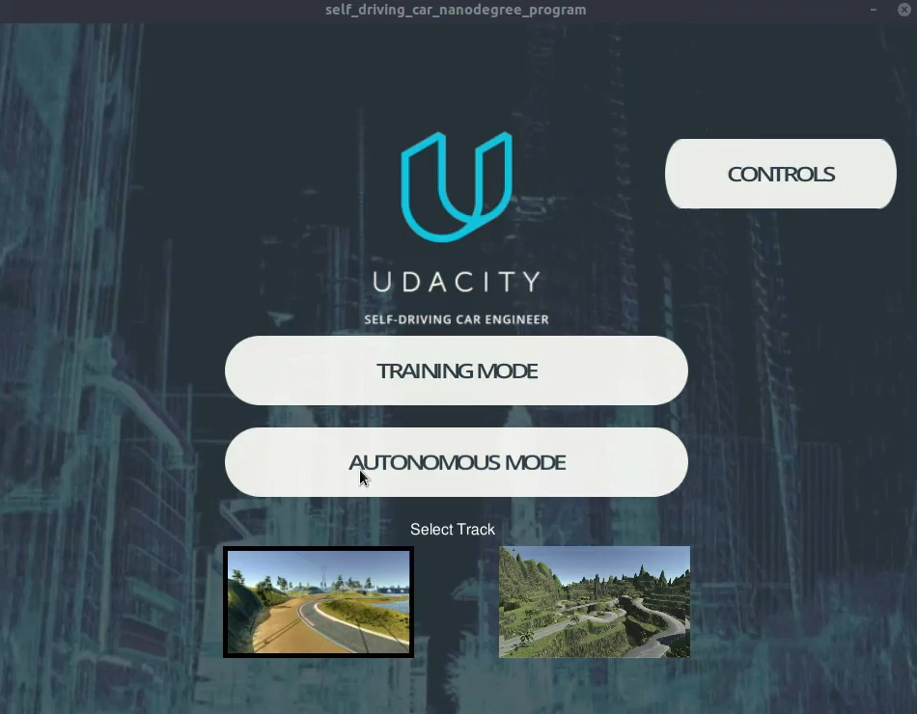
The Result

